Slide 1
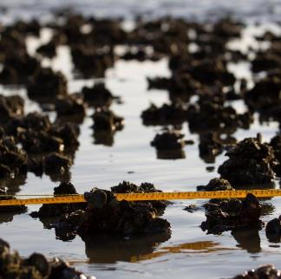
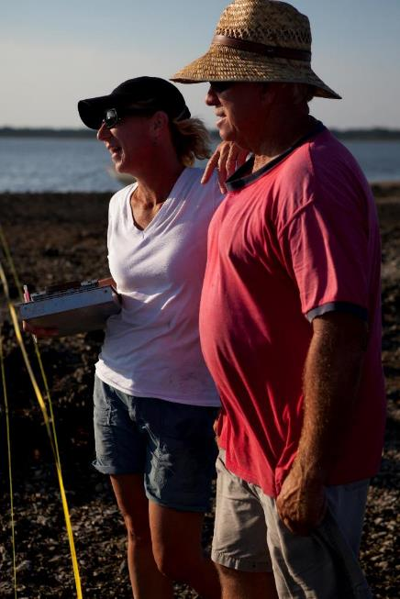
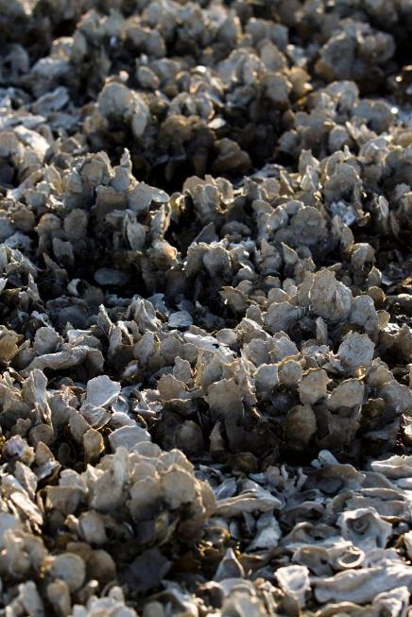
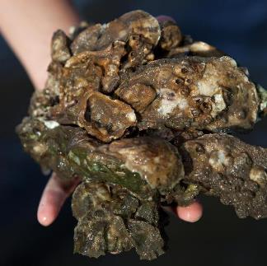

Slide 2
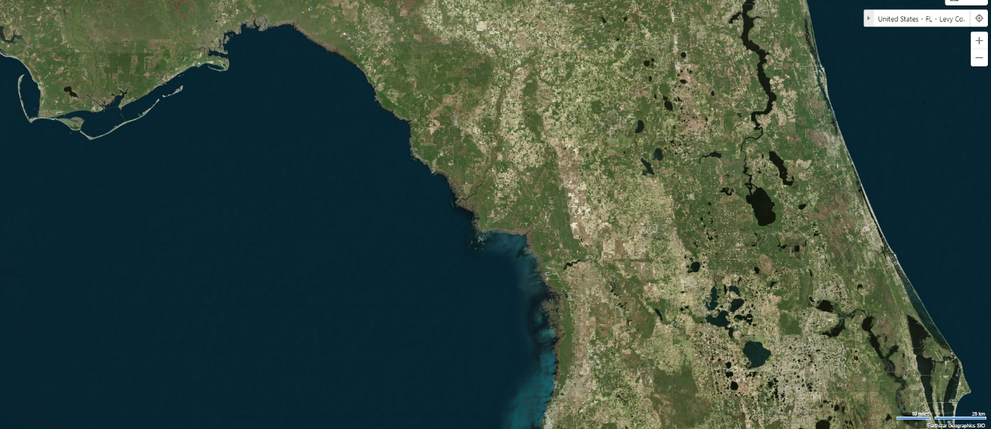
bing.com/maps

Slide 3
Low road and human population density for FL and coastal US
30% of land area and 100-km of coastline protected status
13% private sector employment and 25% of all economic activity tied to natural resources
bing.com/maps

Slide 4
Low road and human population density for FL and coastal US
30% of land area and 100-km of coastline protected status
13% private sector employment and 25% of all economic activity tied to natural resources
bing.com/maps

Slide 5
Suwannee River 60% of freshwater input to Big Bend
Most of river basin in Georgia
Free-flowing but modified river discharge
Largest estuary in Big Bend
Highest commercial oyster landings in FL since 2016, trips since 2017
River discharge influences salinity in Suwannee Sound
bing.com/maps

Slide 6
Suwannee Sound
Stakeholder observed changes in oyster reef distribution and abundance
Seavey et al. 2011 changes in intertidal oysters 1982-2011
Imagery and field assessments
Offshore = -88%
Nearshore = -61%
Inshore = -50%

Slide 7
Suwannee Sound
Key questions:
Are there temporal trends in intertidal oyster counts at these localities and sites?
If so, is there a relationship with freshwater discharge from Suwannee River?
Can we detect an effect of fishing between areas open and closed to seasonal harvest?
Irregular monitoring since 2010
Each year 2 periods = 18 total periods

Slide 8
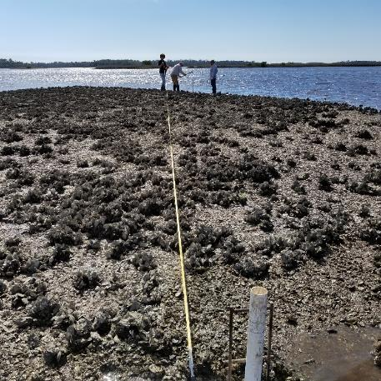
Suwannee Sound

Slide 9
Intertidal surveys
Four localities

Slide 10
Intertidal surveys
Four localities

Slide 11
Intertidal surveys
Four localities

Slide 12
Intertidal surveys
Four localities

Slide 13
Intertidal surveys
Linear chains of reefs at each locality
Inshore
Nearshore
Offshore

Slide 14
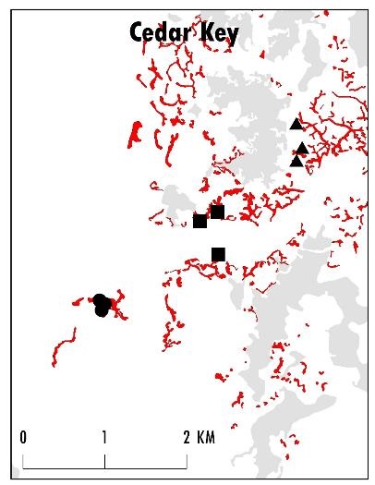
Intertidal surveys

Slide 15
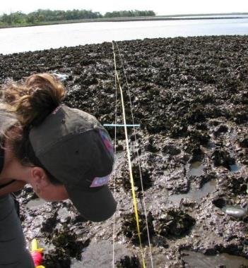
Intertidal surveys
Survey >3 intertidal reefs at each site using line transect

Slide 16
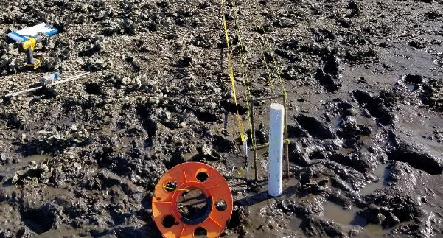
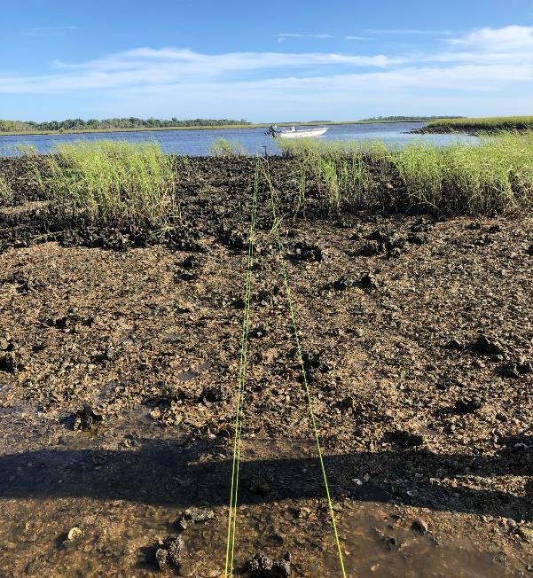
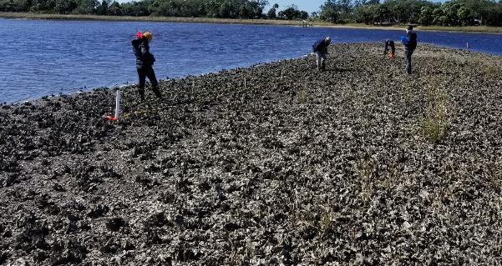

Slide 17

Data
Average individual transect length ~30-m
Counts of live and dead oysters > 5-mm
Summed counts from individual reef transects within site (i.e., sum 3 inshore reefs)

Slide 18
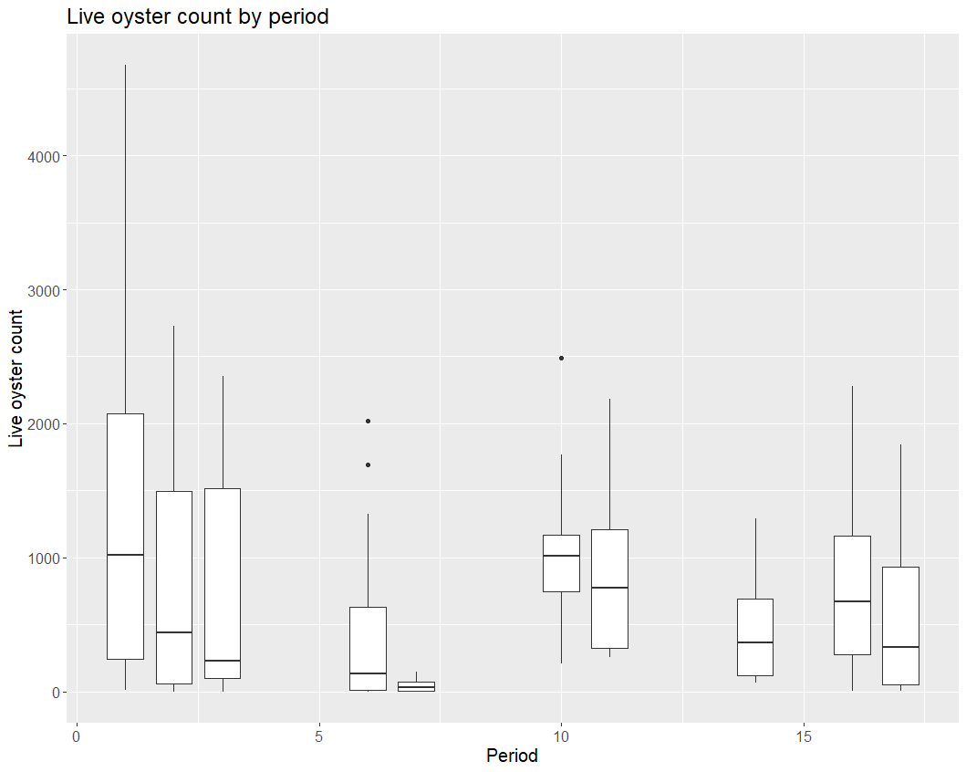

Slide 19
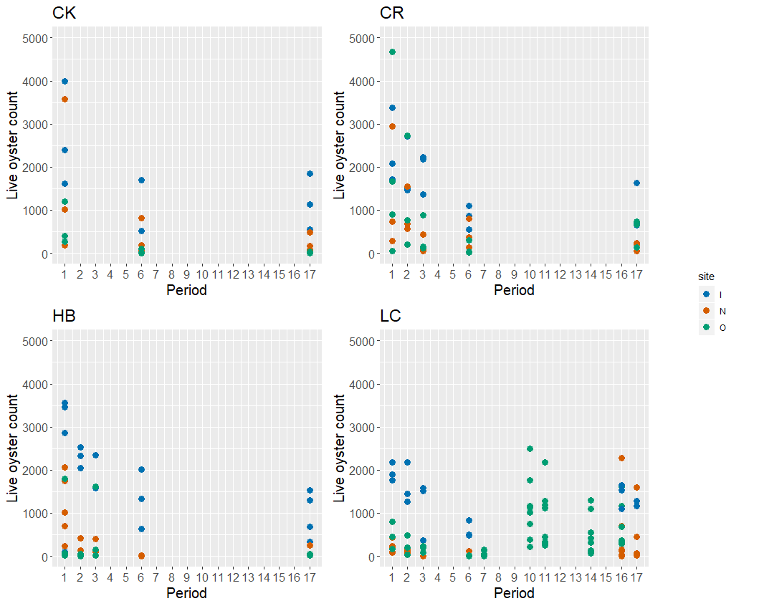

Slide 20
Data
Count data
High variation in counts
variance > mean
Negative binomial good fit
Transect length as effort offset (log link function)

Slide 21

Candidate Models
Fit GLM models using glmmTMB in R assuming negative binomial
Live oyster counts by period
“Biological” covariates
River discharge with 0, 1, 2-year lags
Oyster landings or trips with 0, 1, 2-year lags
Assessed model performance with simulation

Slide 22
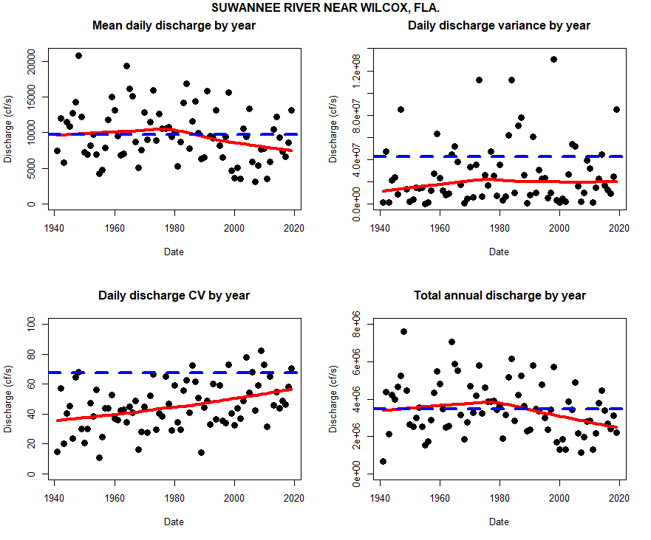

Slide 23
Results
Oyster counts declined significantly at each location and site
Largest changes found in inshore reefs
Inshore becoming like offshore and nearshore

Slide 24
Results
Best fit
Period*site+locality+ offset(log(tran_length)
With covariates
Included one-year lag on either total annual or mean annual discharge
Including landings, trips or area open/closed did not improve model fit

Slide 25
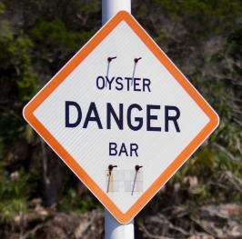
River discharge oyster count relationship?
Yes, but its complicated
Don’t assume that more water = more oysters
One aspect of resilient oyster reefs

Slide 26
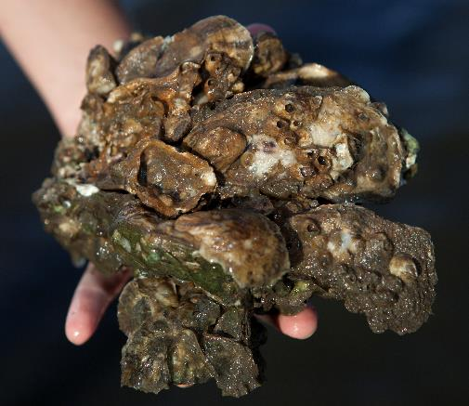
Fishing effects?
No, but its complicated
Intertidal bars have few legal oysters due to growth
Fishing effort effects unclear
Complicated source-sink dynamics and feedbacks

Slide 27
What do we do?

Slide 28
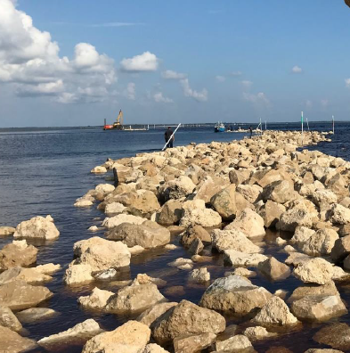
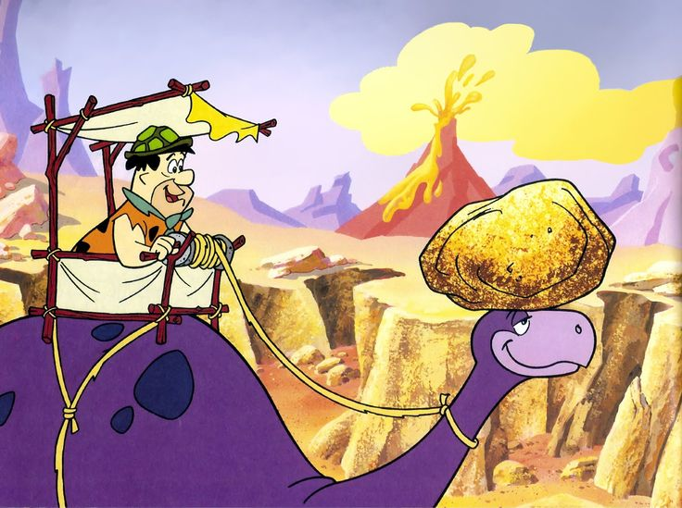
What do we do? Restoration?

Slide 29
What do we do? But what about SLR?

Slide 30
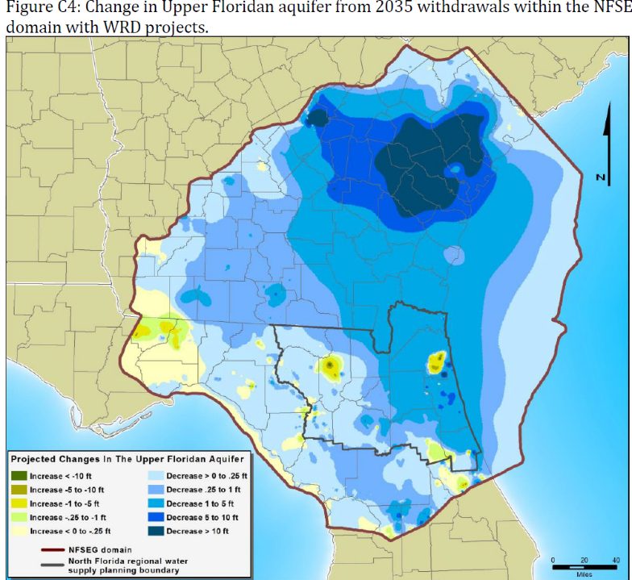
Latest groundwater models forecast declines for nearly all of Suwannee Basin by 2035 BEST CASE SCENARIO
http://northfloridawater.com/

Slide 31
Eastern front of the
FL v GA water wars??
http://northfloridawater.com/

Slide 32
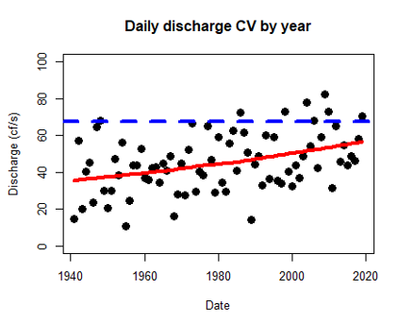

Slide 33
Way forward: Use environmental contrasts, management regulations, and restoration efforts as planned experiments at large spatial scales to learn how to better manage oyster resources or

Slide 36
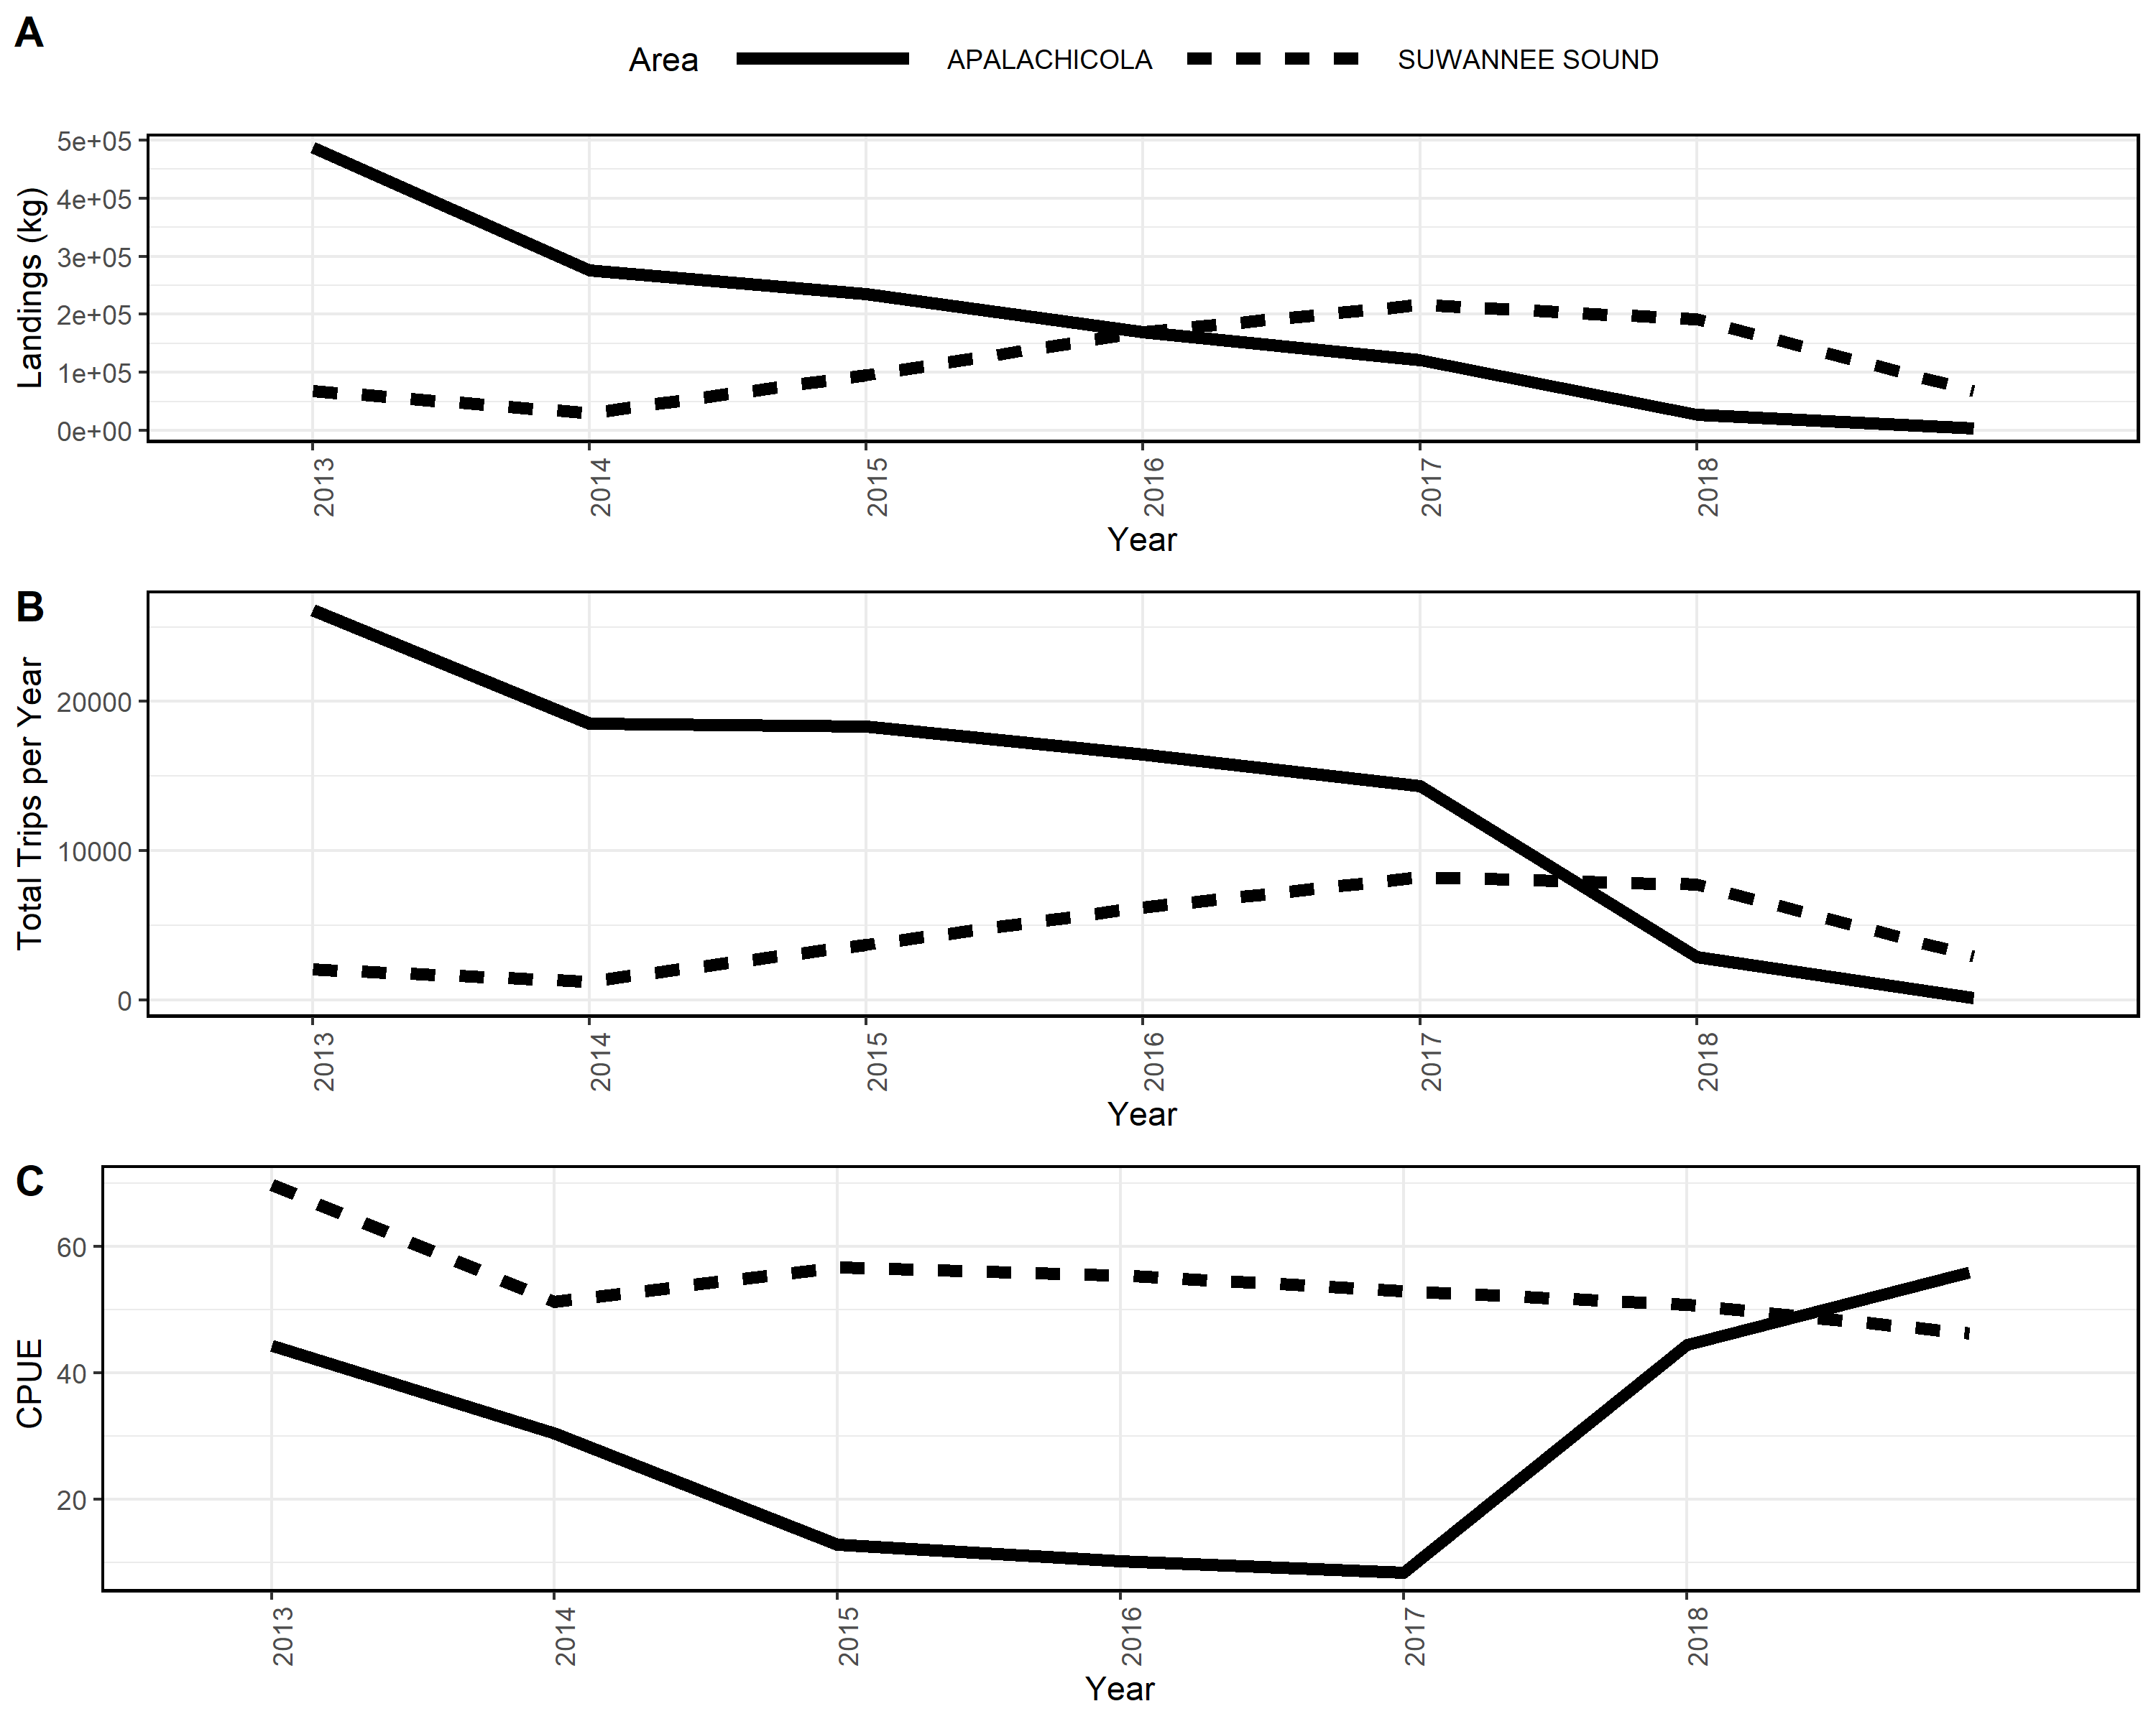

Slide 37
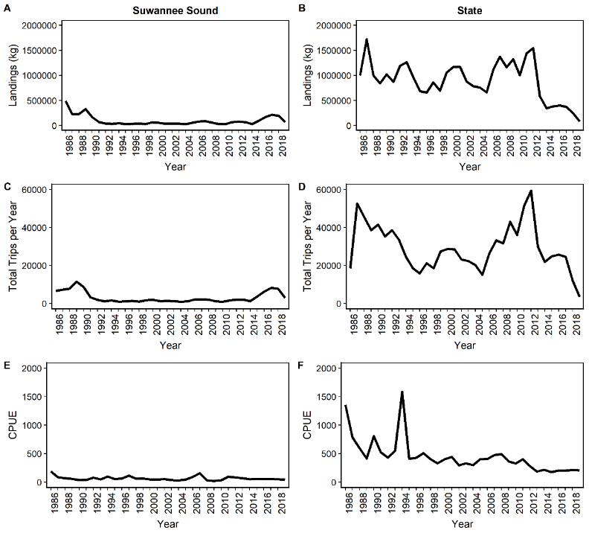

Slide 42
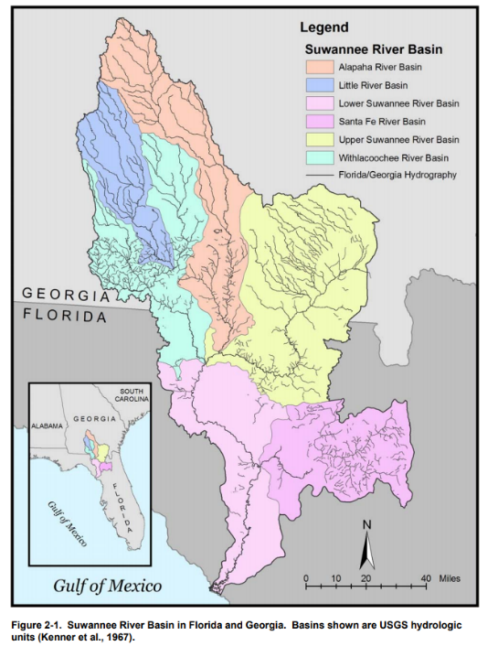
Suwannee River and Estuary
Suwannee River 60% of freshwater input to Big Bend
River discharge modified by surface and subsurface withdrawals
Largest estuary in region
River discharge influences salinity in Suwannee Sound
http://www.srwmd.state.fl.us/DocumentCenter/View/72/Suwannee-River-Basin-Florida-Georgia-Map---PDF?bidId=

